Slide 1
CMOS Analog-to-Digital Converter Using Voltage-Controlled Oscillator and D Flip-Flop
Presented By:
K. Eswar Adithya (12311440)
Sarath Kumar Suda(12312393)

Slide 2
Introduction
An Analog-to-Digital Converter (ADC) is a vital component in modern electronics, enabling digital systems to process real-world analog signals.
• This project focuses on designing an ADC using CMOS technology in a 90nm process.
The ADC consists of two main components:
Voltage-Controlled Oscillator (VCO): Converts the input analog voltage into a frequency signal.
D Flip-Flops (DFFs): Digitize the frequency signal into binary data.
• The goal is to achieve a low-power, high-performance ADC suitable for energy-efficient applications.
• The design has been tested using Cadence Virtuoso tools to validate functionality, power consumption, and process variations.

Slide 3
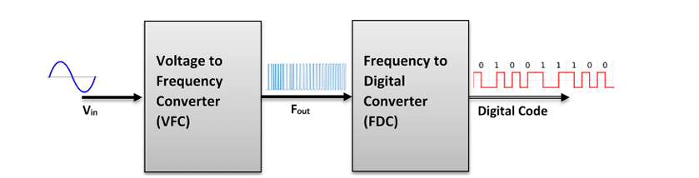
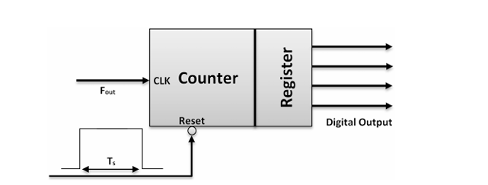
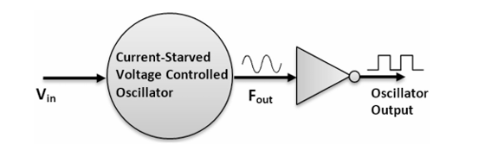
Block Diagram

Slide 4
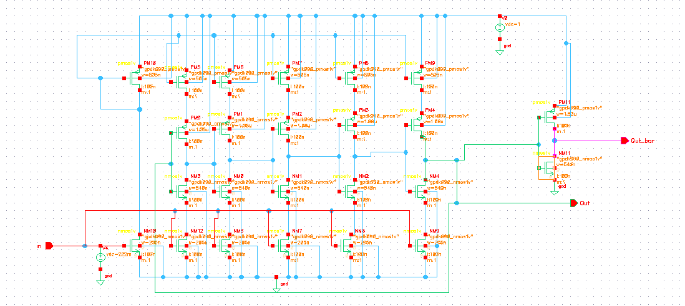
VCO Schematic

Slide 5
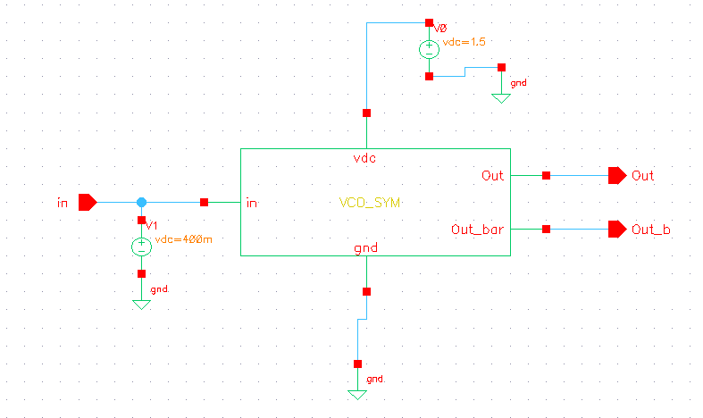
VCO Symbol

Slide 6
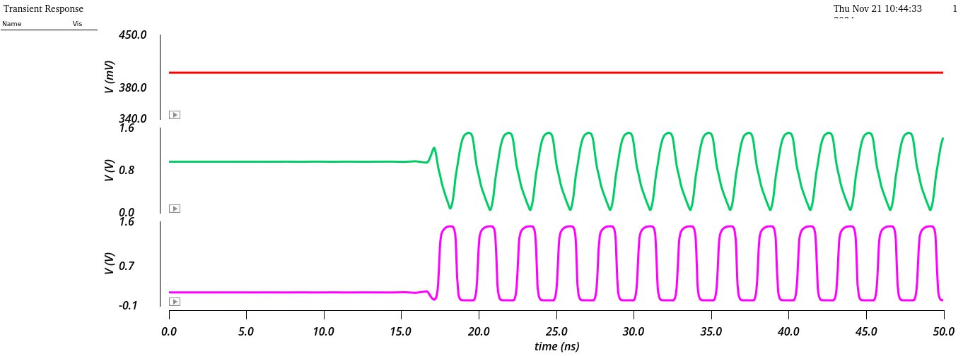
VCO Waveform

Slide 7
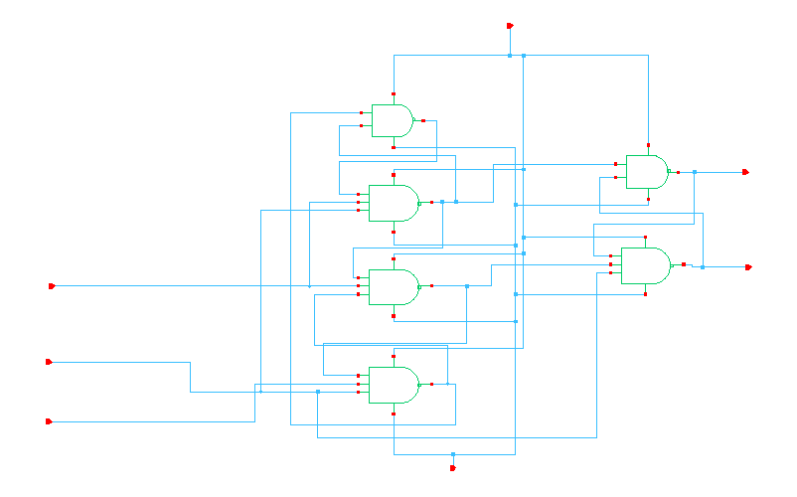
D Flip-Flop Circuit

Slide 8
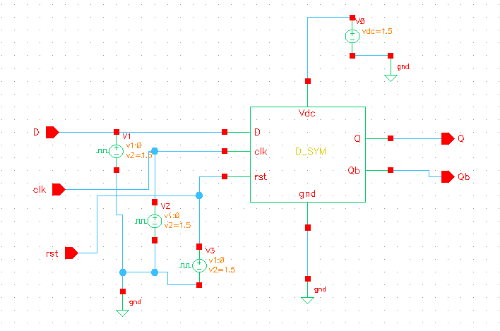
D Flip-Flop Symbol

Slide 9
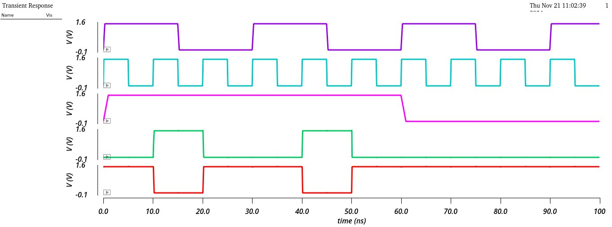
D Flip-Flop Waveform

Slide 10
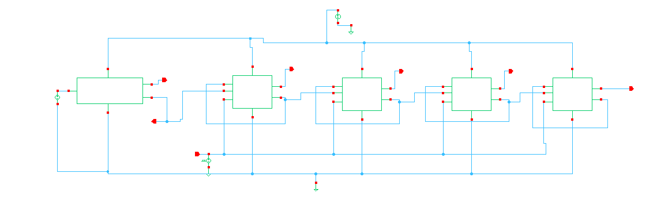
ADC Using VCO

Slide 11
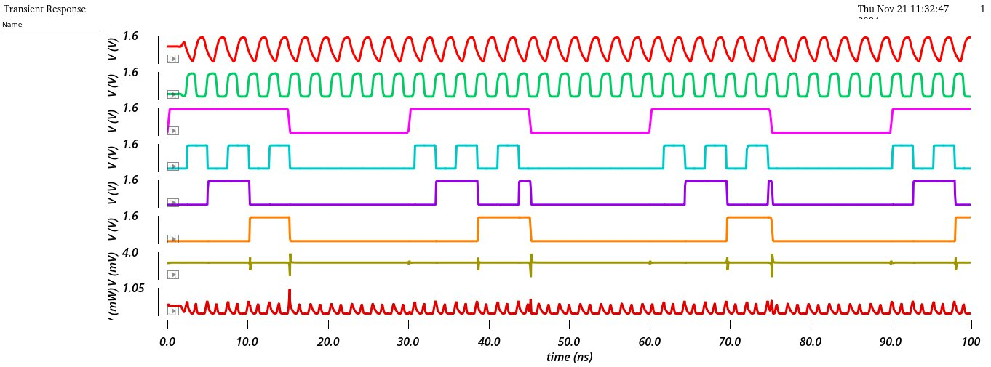
ADC Waveform (0.4V)

Slide 12
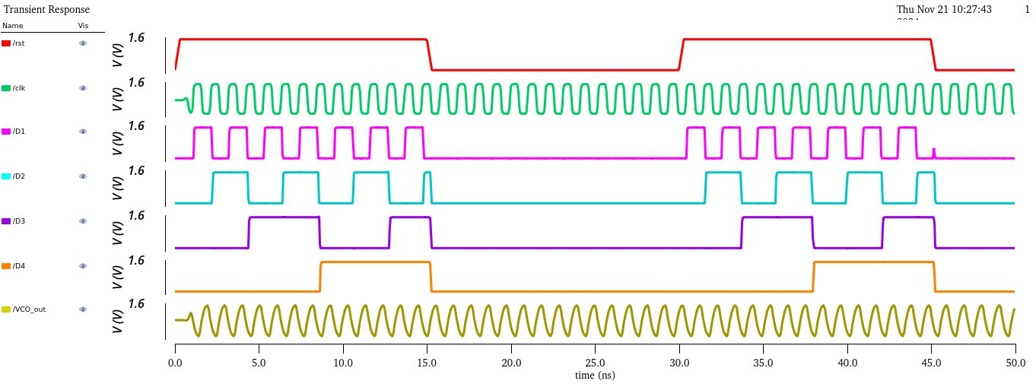
ADC Waveform (0.6V)

Slide 13
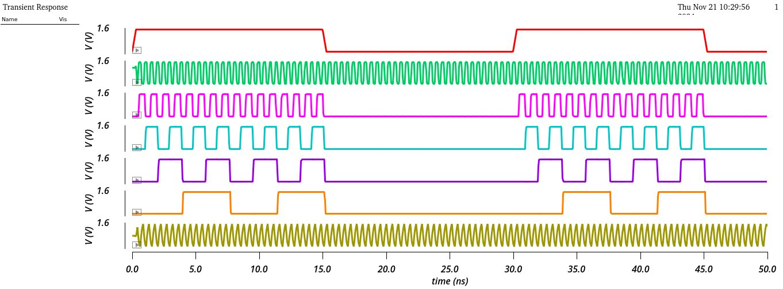
ADC Waveform (1.0V)

Slide 14
Power at Different Corners
Corners | Average Power (Watts)
Typical Typical (TT) | 193.2 x 10 ^ -6 W
Fast Fast (FF) | 275.8 x 10 ^ -6 W
Slow Slow (SS) | 124.1 x 10 ^ -6 W
Fast Slow (FS) | 220.0 x 10 ^ -6 W
Slow Fast (SS) | 155.7 x 10 ^ -6 W

Slide 15
Applications
Communication Systems: Converts analog signals into digital for wireless communication.
Medical Devices: Used in ECG, pulse oximeters, and imaging systems.
Audio Processing: Converts audio signals in microphones and sound cards.
Control Systems: Processes analog feedback in automation and robotics.
Data Acquisition Systems: Used for real-time data processing and storage.

Slide 16
Conclusion
The analysis of the ADC system demonstrates its performance across different input voltages and process corners. The average power consumption increases with the input voltage, reflecting the higher switching activity and faster circuit operation.
The corner analysis provides valuable insights into the ADC's behaviour under various conditions. The minimum power consumption is observed at the SS Corner (Slow-S and Slow-S), where the system operates with slower transistors, leading to reduced power consumption. Specifically, the ADC achieves a minimum power consumption of 124.1 × 10⁻⁶ W at the SS Corner, indicating a balance between lower speed and reduced energy usage.
This study highlights the ADC's efficiency and performance under varying conditions, with the SS corner offering the most energy-efficient operation.

Slide 17

References
1. Liu, L., & Lee, H. M. (2010). "A Low-Power CMOS Analog-to-Digital Converter for High-Speed Applications." IEEE Journal of Solid-State Circuits, 45(6), 1153-1161.
2. Baker, R. J. (2008). CMOS: Circuit Design, Layout, and Simulation. Wiley-IEEE Press.
3. Razavi, B. (2001). Design of Analog CMOS Integrated Circuits. McGraw-Hill.
4. Gray, P. R., Hurst, P. J., Lewis, S. H., & Meyer, R. G. (2001). Analysis and Design of Analog Integrated Circuits. Wiley.
5. Sze, S. M., & Ng, K. K. (2006). Physics of Semiconductor Devices (3rd ed.). Wiley-Interscience.
6. Tee, M. K., & Cheng, K. W. (2013). "A 10-Bit CMOS ADC Using a Voltage-Controlled Oscillator." IEEE Transactions on Circuits and Systems II: Express Briefs, 60(7), 447-451.
7. Zhou, Y., & Chen, L. (2015). "A CMOS ADC with Improved Power Efficiency Using a Voltage-to-Frequency Conversion Technique." IEEE Transactions on Very Large Scale Integration (VLSI) Systems, 23(4), 659-668.

Slide 18
Thank You

